Slide 1

Lecture
on
“CBNST LAB –PMA-402”
by
Akansha Gupta
DEPARTMENT OF COMPUTER SCIENCE AND ENGINEERING
GRAPHIC ERA DEEMED TO BE UNIVERSITY

Slide 2
NEWTON RAPHSON METHOD

Slide 3
Newton Raphson Method
Newton Raphson method, also called the Newton’s method, is the fastest and simplest approach of all methods to find the real root of a nonlinear function.
It is an open bracket approach, requiring only one initial guess.
This method is quite often used to improve the results obtained from other iterative approaches.
The convergence is fastest of all the root-finding methods
The overall approach of Newton’s method is more useful in case of large values the first derivative of f(X) i.e f'(X).
The iterative formula for Newton Raphson method is:
Xn+1 = Xn – f(Xn)/f'(Xn)

Slide 4
Features of Newton’s Method
Type – open bracket
No. of initial guesses – 1
Convergence – quadratic
Rate of convergence – faster
Accuracy – good
Programming effort – easy
Approach – Taylor’s series

Slide 5
Comparison with Bisection & Regula-Falsi method
In previous methods, we were given an interval. Here we are required an initial guess value of root.
The previous two methods are guaranteed to converge, Newton Rahhson may not converge in some cases.
Newton Raphson method requires derivative. Some functions may be difficult to or impossible to differentiate.
For many problems, Newton Raphson method converges faster than the above two methods.
Also, it can identify repeated roots, since it does not look for changes in the sign of f(x) explicitly

Slide 6
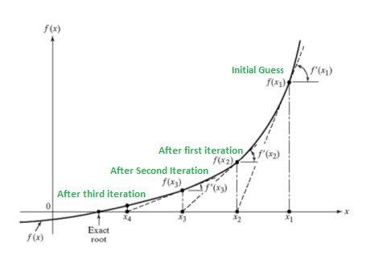
How does this work?
The idea is to draw a line tangent to f(x) at point x₁. The point where the tangent line crosses the x axis should be a better estimate of the root than x₁. Call this point x₂. Calculate f(x₂), and draw a line tangent at x₂.
We know that slope of line from (x₁, f(x₁)) to (x₂, 0) is f'(x₁)) where f’ represents derivative of f.

Slide 7
Newton Raphson MethodAlgorithm
Start
Read x, e, n, d *x is the initial guess e is the absolute error i.e the desired degree of accuracy n is for operating loop d is for checking slope*
Do for i =1 to n in step of 2
f = f(x)
f1 = f'(x)
If ( [f1] < d), then display too small slope and goto 11. *[ ] is used as modulus sign*
x1 = x – f/f1
If ( [(x1 – x)/x1] < e ), the display the root as x1 and goto 11. *[ ] is used as modulus sign*
x = x1 and end loop
Display method does not converge due to oscillation.
Stop

Slide 8
Pseudocode for Newton Raphson Method
Start
2. Define function as f(x)
3. Define derivative of function as g(x)
4. Input:
a. Initial guess x0
b. Tolerable Error e
c. Maximum Iteration N
5. Initialize iteration counter step = 1
6. Do
If g(x0) = 0
Print "Mathematical Error"
Stop
End If
x1 = x0 - f(x0) / g(x0)
x0 = x1
step = step + 1
If step > N
Print "Not Convergent"
Stop
End If
While abs f(x1) > e
7. Print root as x1
8. Stop

Slide 9

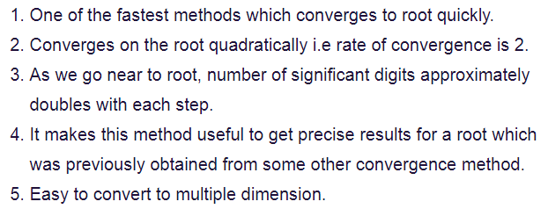

Slide 10
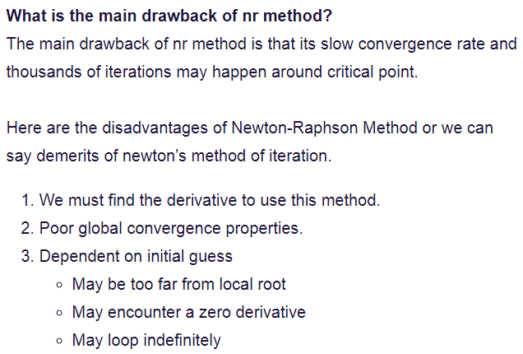

Slide 11
https://youtu.be/6qyDCV6QOm0
THANKS

